Slide 1
Economic Factors Impacting Home Ownership
Team 5
Andrew Perez, Brent Meulebroeck,
Gary Jeter, Michael Badinger

Slide 2
Home Ownership Analysis
There is common belief that home ownership in the United States is the most impactful means of building wealth.
This study analyzed data from 2006 to 2019 in all 50 states to identify factors impacting home ownership rates.
Data Source: GeoFRED: Federal Reserve Bank of St. Louis Economic Research (daily updates from 750K financial & economic data series from 100+ sources)

Slide 3
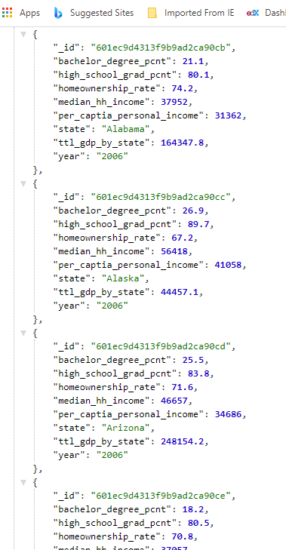
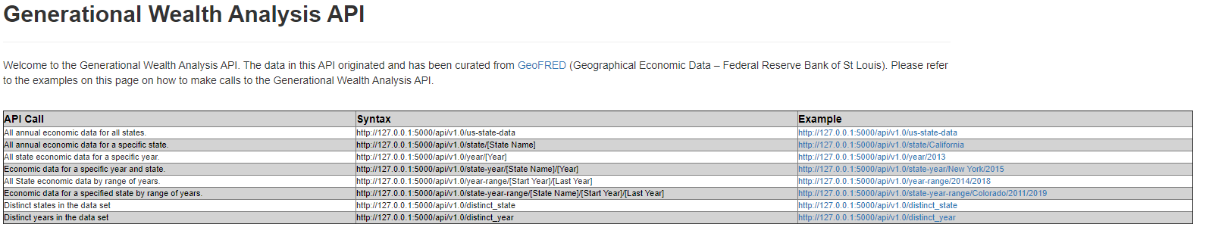
Visual Analysis Website Data Base Design
Andrew Perez

Slide 4
Visual Analysis Website Demo
Pair Plot Analysis – Gary Jeter
Education Analysis – Brent Meulebroeck
Line/ Bar Plot Analysis – Michael Badinger
Boxplot Analysis – Andrew Perez

Slide 5
Conclusion
US has become more educated over the last 15 years as measured by high school and college graduates
Higher home ownership rates in the poorer states with a lower educated population
Variation of wealth has increased over time while home ownership variation has not.
Education is much better predictor of wealth than home ownership

